Slide 1
Entity-Relationship Model

Slide 2
Outline
Modeling
Constraints
E-R Diagram
Design Issues
Weak Entity Sets
Extended E-R Features
Design of the Bank Database
Reduction to Relation Schemas

Slide 3
Modeling
A database can be modeled as:
a collection of entities,
relationship among entities.
An entity is an object that exists and is distinguishable from other objects.
Example: specific person, company, event, plant
Entities have attributes
Example: people have names and addresses
An entity set is a set of entities of the same type that share the same properties.
Example: set of all persons, companies, trees, holidays

Slide 4
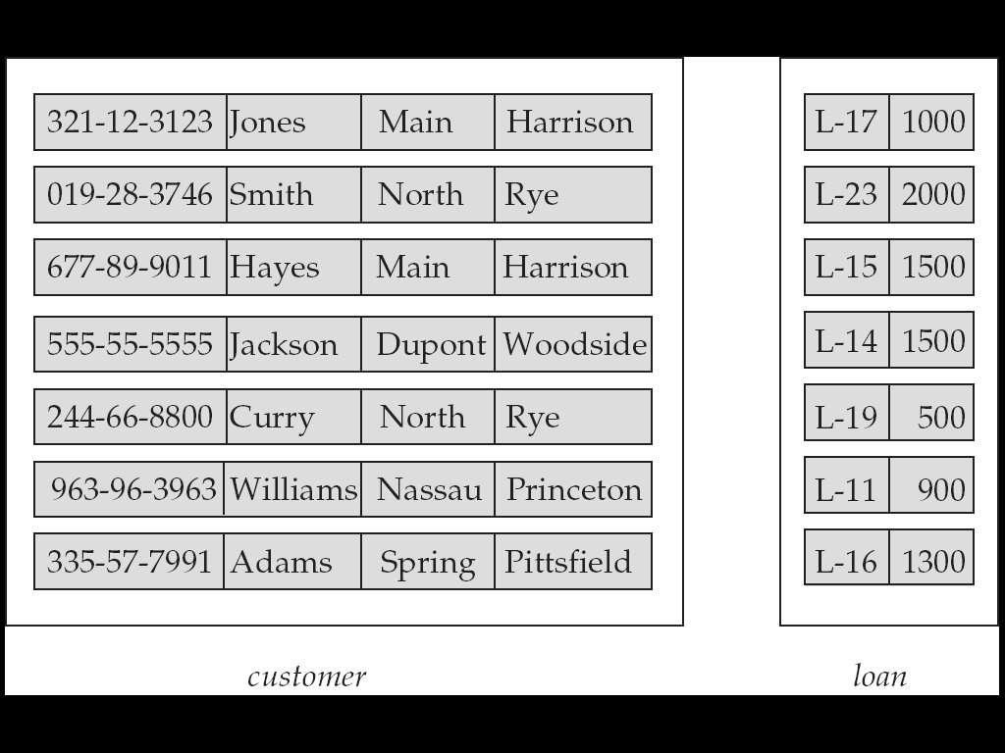
Entity Sets customer and loan

Slide 5
Relationship
A relationship is an association among several entities
Example: Hayes depositor A-102 customer entity relationship set account entity
A relationship set is a mathematical relation among n ≥ 2 entities, each taken from entity sets
{(e₁, e₂, … e_{n}) | e₁ ∈ E₁, e₂ ∈ E₂, …, e_{n} ∈ E_{n}} where (e₁, e₂, …, e_{n}) is a relationship
Example:
(Hayes, A-102) ∈ depositor

Slide 6
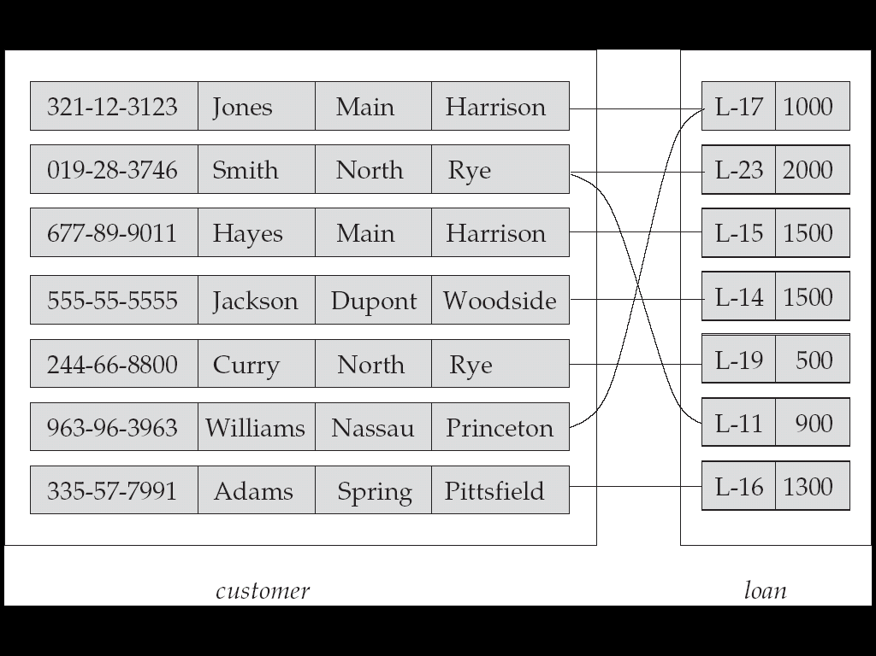
Relationship set Barrower

Slide 7
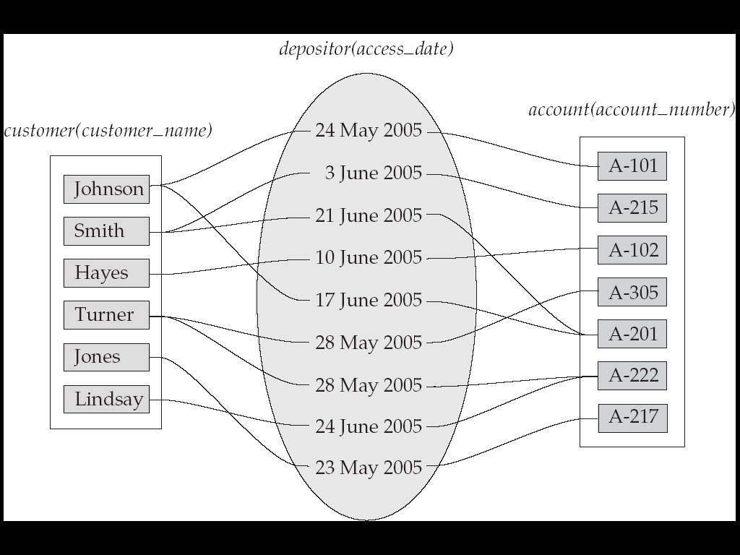
Relationship set
An attribute can also be property of a relationship set.
For instance, the depositor relationship set between entity sets customer and account may have the attribute access-date

Slide 8
Degree of a Relationship Set
Refers to number of entity sets that participate in a relationship set.
Relationship sets that involve two entity sets are binary (or degree two). Generally, most relationship sets in a database system are binary.
Relationship sets may involve more than two entity sets.
Relationships between more than two entity sets are rare. Most relationships are binary. (More on this later.)

Slide 9
Attributes
An entity is represented by a set of attributes, that is descriptive properties possessed by all members of an entity set.
Example:
customer = (customer_id, customer_name, customer_street, customer_city ) loan = (loan_number, amount )
Domain – the set of permitted values for each attribute
Attribute types:
Simple and composite attributes.
Single-valued and multi-valued attributes
Example: multivalued attribute: phone_numbers
Derived attributes
Can be computed from other attributes
Example: age, given date_of_birth

Slide 10
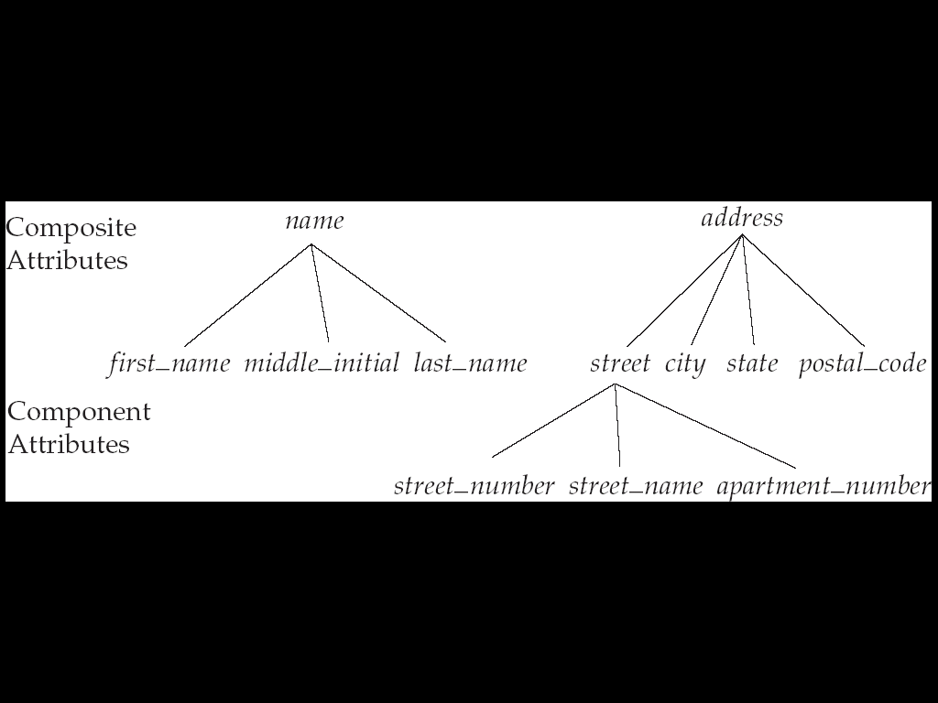
Composite Attributes

Slide 11
Mapping Cardinality Constraints
Express the number of entities to which another entity can be associated via a relationship set.
Most useful in describing binary relationship sets.
For a binary relationship set the mapping cardinality must be one of the following types:
One to one
One to many
Many to one
Many to many

Slide 12
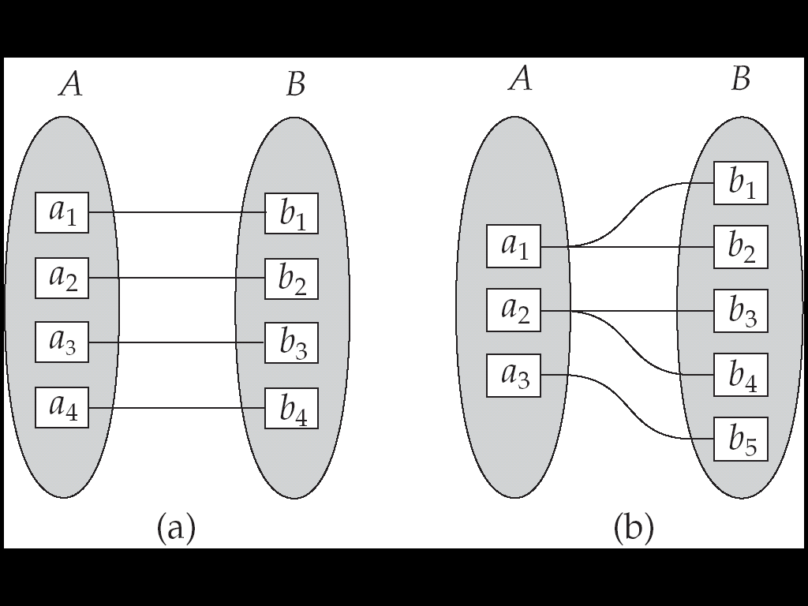
Mapping Cardinalities

Slide 13
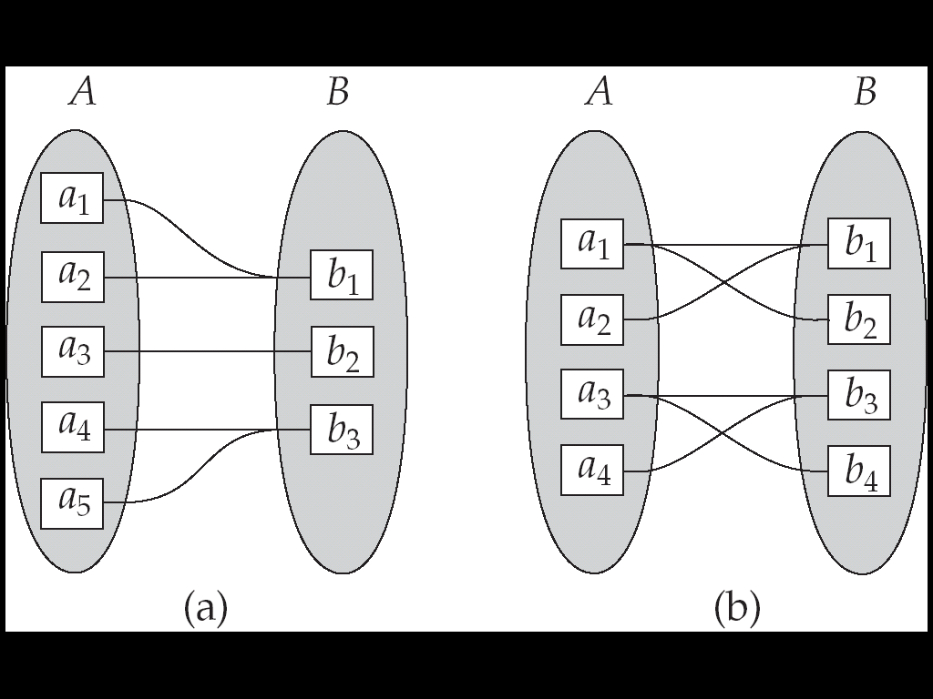

Slide 14
Keys
A super key of an entity set is a set of one or more attributes whose values uniquely dentify each entity.
A candidate key of an entity set is a minimal super key
Customer_id is candidate key of customer
account_number is candidate key of account
Although several candidate keys may exist, one of the candidate keys is selected to be the primary key.

Slide 15
Keys for Relationship sets
The combination of primary keys of the participating entity sets forms a super key of a relationship set.
(customer_id, account_number) is the super key of depositor
NOTE: this means a pair of entity sets can have at most one relationship in a particular relationship set.
Example: if we wish to track all access_dates to each account by each customer, we cannot assume a relationship for each access. We can use a multivalued attribute though
Must consider the mapping cardinality of the relationship set when deciding what are the candidate keys
Need to consider semantics of relationship set in selecting the primary key in case of more than one candidate key

Slide 16
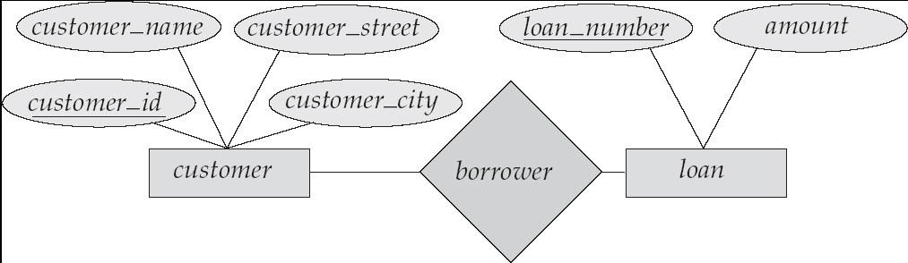
ER Diagram
Rectangles represent entity sets.
Diamonds represent relationship sets.
Lines link attributes to entity sets and entity sets to relationship sets.
Ellipses represent attributes
Double ellipses represent multivalued attributes.
Dashed ellipses denote derived attributes.
Underline indicates primary key attributes (will study later)

Slide 17
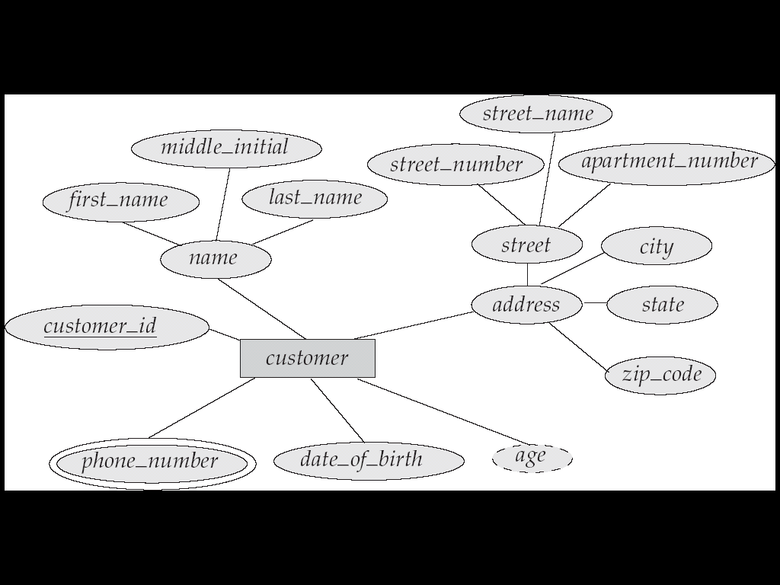
E-R Diagram With Composite, Multivalued, and Derived Attributes

Slide 18
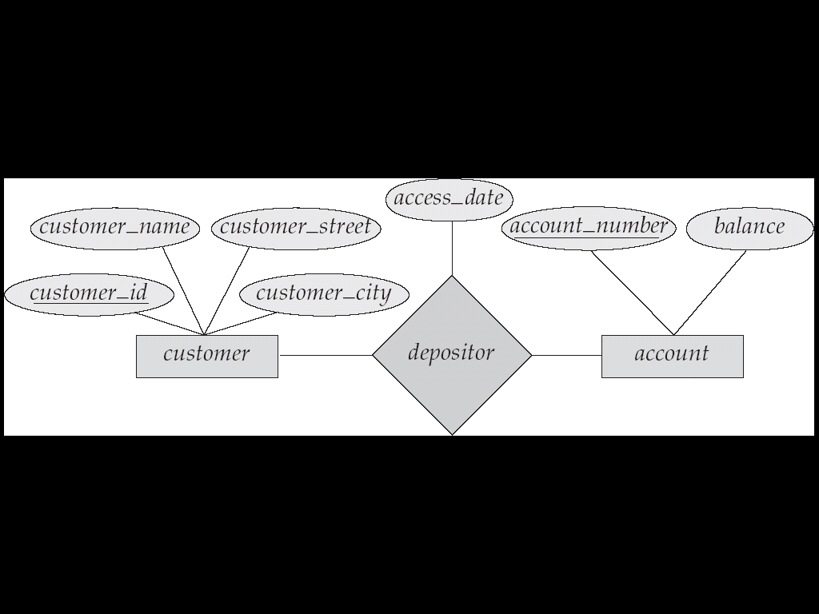
Relationship Sets with Attributes

Slide 19
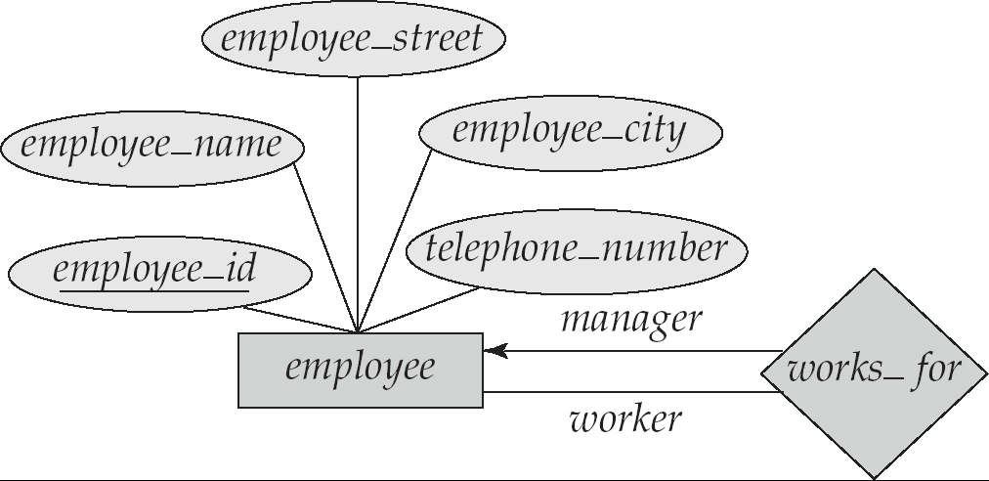
Roles
Entity sets of a relationship need not be distinct
The labels “manager” and “worker” are called roles; they specify how employee entities interact via the works_for relationship set.
Roles are indicated in E-R diagrams by labeling the lines that connect diamonds to rectangles.
Role labels are optional, and are used to clarify semantics of the relationship

Slide 20
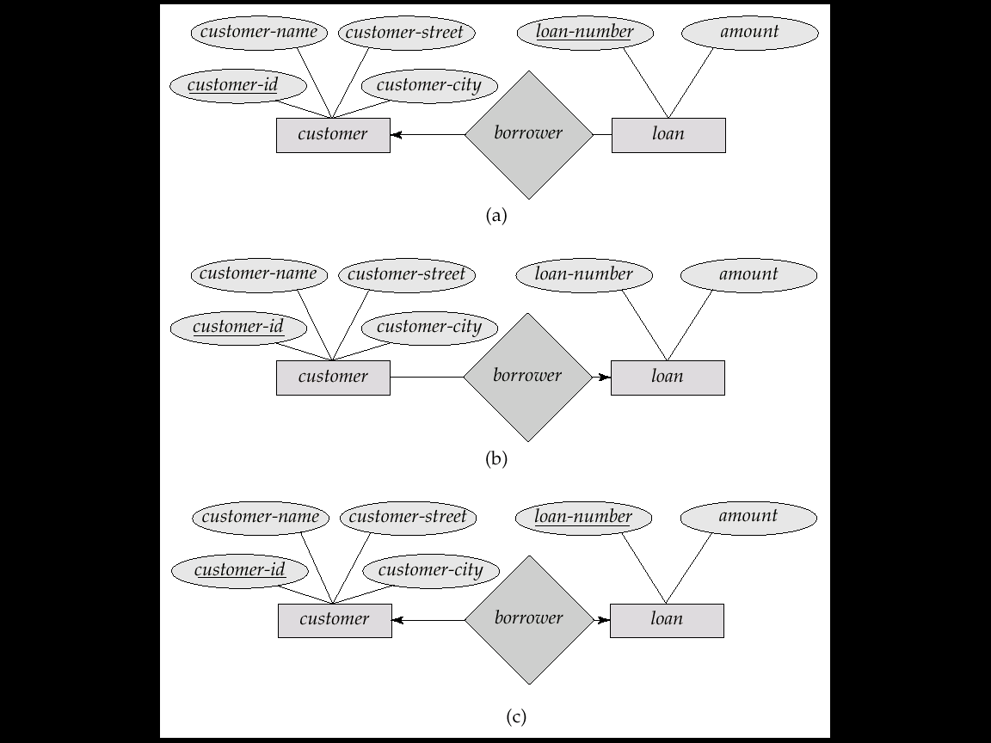
Cardinality Constraints
We express cardinality constraints by drawing either a directed line (→), signifying “one,” or an undirected line (—), signifying “many,” between the relationship set and the entity set.
One-to-one relationship:
A customer is associated with at most one loan via the relationship borrower
A loan is associated with at most one customer via borrower
In the one-to-many relationship a loan is associated with at most one customer via borrower, a customer is associated with several (including 0) loans via borrower

Slide 21
Many to One
In a many-to-one relationship a loan is associated with several (including 0) customers via borrower, a customer is associated with at most one loan via borrower

Slide 22
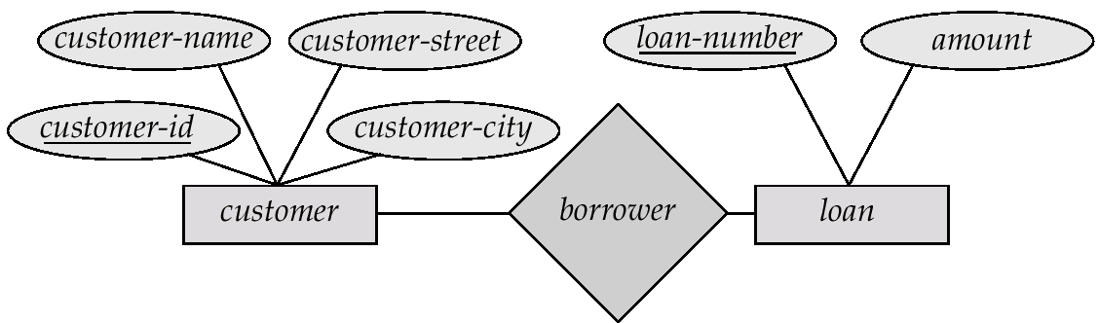
Many To Many
A customer is associated with several (possibly 0) loans via borrower
A loan is associated with several (possibly 0) customers via borrower

Slide 23
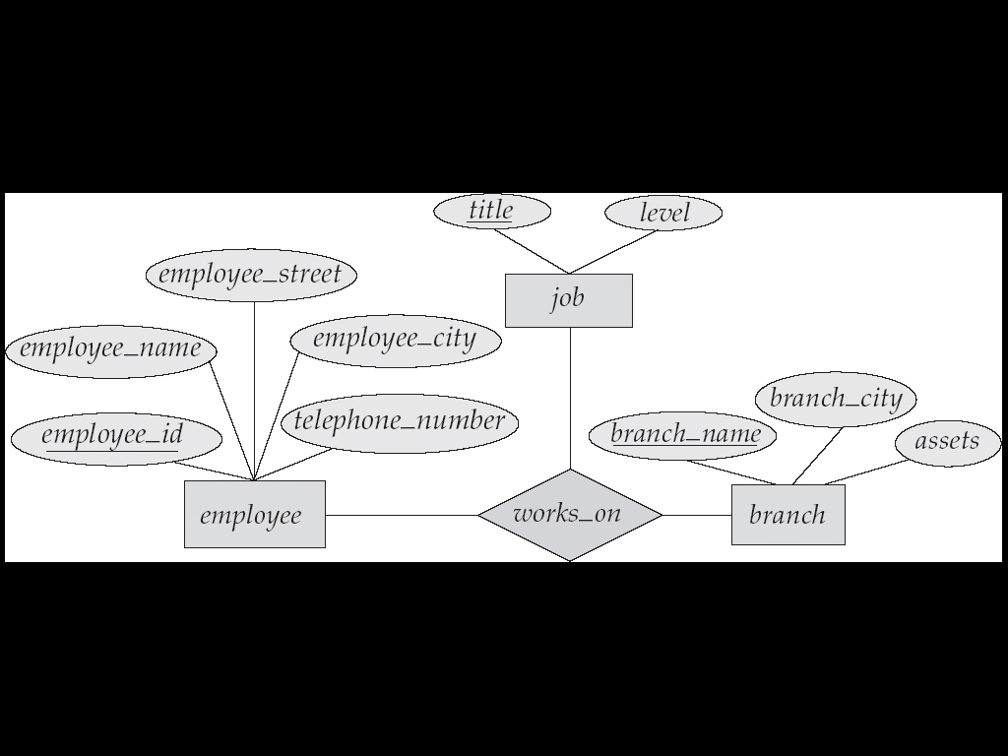
E-R Diagram with a Ternary Relationship

Slide 24
Week Entity Set
An entity set that does not have a primary key is referred to as a weak entity set.
The existence of a weak entity set depends on the existence of a identifying entity set
it must relate to the identifying entity set via a total, one-to-many relationship set from the identifying to the weak entity set
Identifying relationship depicted using a double diamond
The discriminator (or partial key) of a weak entity set is the set of attributes that distinguishes among all the entities of a weak entity set.
The primary key of a weak entity set is formed by the primary key of the strong entity set on which the weak entity set is existence dependent, plus the weak entity set’s discriminator.

Slide 25
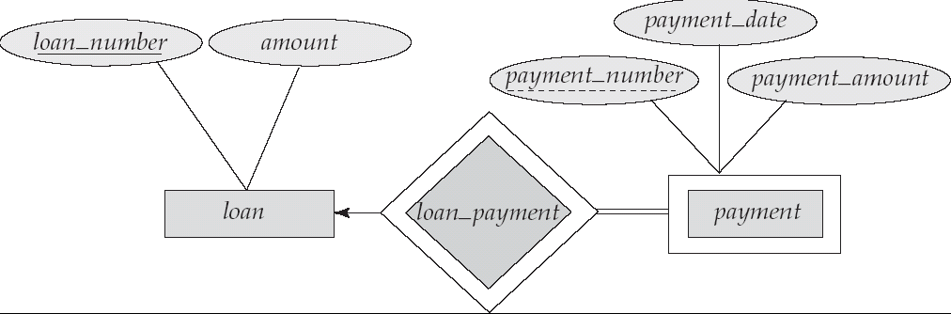
Weak Entity set
We depict a weak entity set by double rectangles.
We underline the discriminator of a weak entity set with a dashed line.
payment_number – discriminator of the payment entity set
Primary key for payment – (loan_number, payment_number)

Slide 26
Continued…
Note: the primary key of the strong entity set is not explicitly stored with the weak entity set, since it is implicit in the identifying relationship.
If loan_number were explicitly stored, payment could be made a strong entity, but then the relationship between payment and loan would be duplicated by an implicit relationship defined by the attribute loan_number common to payment and loan

Slide 27
Specialization
Top-down design process; we designate subgroupings within an entity set that are distinctive from other entities in the set.
These subgroupings become lower-level entity sets that have attributes or participate in relationships that do not apply to the higher-level entity set.
Depicted by a triangle component labeled ISA (E.g. customer “is a” person).
Attribute inheritance – a lower-level entity set inherits all the attributes and relationship participation of the higher-level entity set to which it is linked.

Slide 28
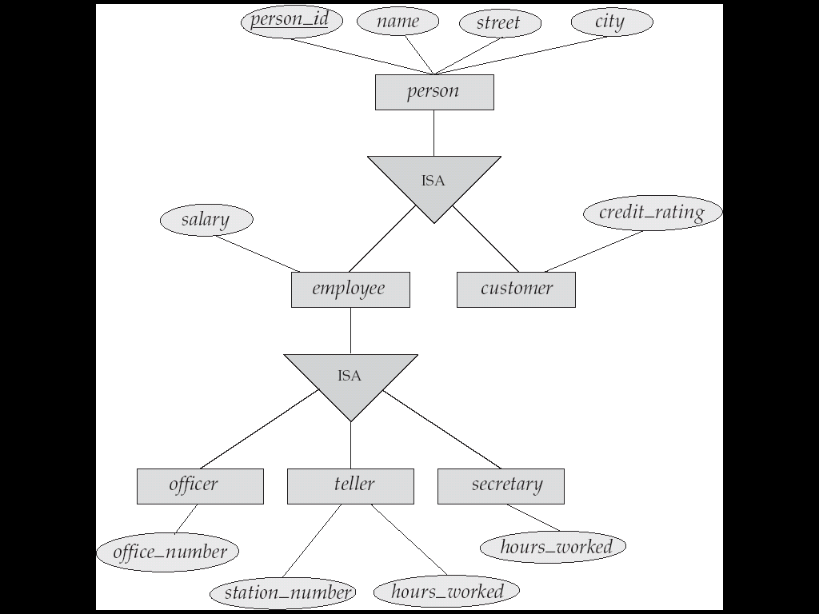

Slide 29
Generalization
A bottom-up design process – combine a number of entity sets that share the same features into a higher-level entity set.
Specialization and generalization are simple inversions of each other; they are represented in an E-R diagram in the same way.
The terms specialization and generalization are used interchangeably.
Can have multiple specializations of an entity set based on different features.
E.g. permanent_employee vs. temporary_employee, in addition to officer vs. secretary vs. teller
Each particular employee would be
a member of one of permanent_employee or temporary_employee,
and also a member of one of officer, secretary, or teller
The ISA relationship also referred to as superclass - subclass relationship

Slide 30
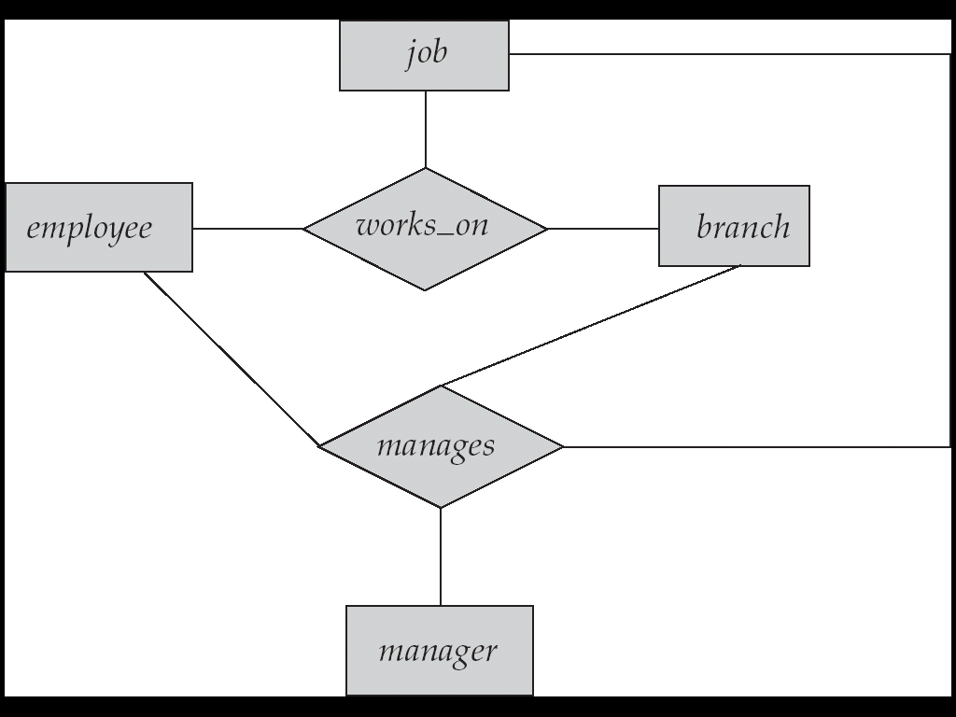
Aggregation
Consider the ternary relationship works_on, which we saw earlier
Suppose we want to record managers for tasks performed by an employee at a branch

Slide 31
Relationship sets works_on and manages represent overlapping information
Every manages relationship corresponds to a works_on relationship
However, some works_on relationships may not correspond to any manages relationships
So we can’t discard the works_on relationship
Eliminate this redundancy via aggregation
Treat relationship as an abstract entity
Allows relationships between relationships
Abstraction of relationship into new entity
Without introducing redundancy, the following diagram represents:
An employee works on a particular job at a particular branch
An employee, branch, job combination may have an associated manager

Slide 32
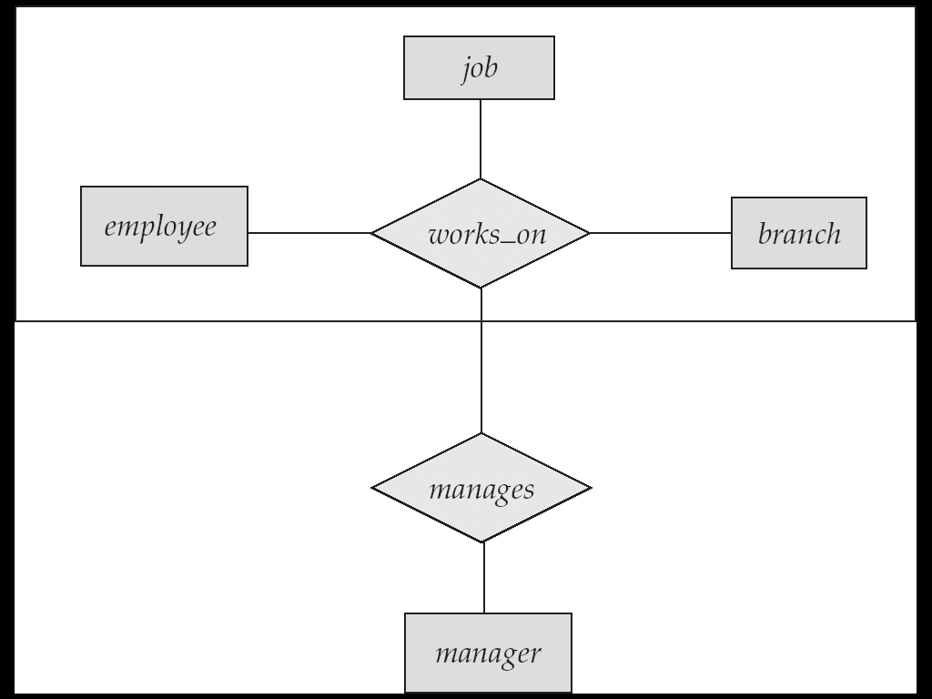
ER Diagram Aggregation

